Slide 1
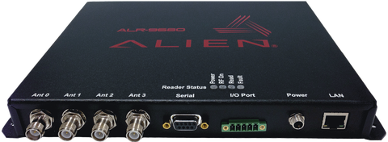



RFID Tracking/Security System Joshua Kirkpatrick (EE) - Okebaram Ekwuribe (EE) - Shadman Sharif (EE) - Aoyu Li (EE) - Michael Wyzykowski (EE)
UTDESIGN II
Design
Reader Flow
Database
Created through MySQL
Consists of inventory list and received data list
Compares received data against inventory list and will send alert to security personnel if a match is detected
Automatically updates as new data is received
Wait
Database Flow
Scanner
Covers entirety of worksite entrance/exit (5-12 foot range)
Will operate continuously
Automatically creates notification containing tag data that will be output to database
ALR-9680 stationary scanner
Display Matching Data
AutoStart Trigger
No
Compile Matching Data
AutoAction
Compare Tables
Notification Needed?
No
Scanner List
Tool List
Performance Metric
The project will be considered a success if the system automatically scans a tool and creates a notification that contains the tag data. Database will compare scanned data to inventory and will display an alert if there is a match.
Goal
Our goal is to design a system to prevent company assets from leaving the worksite without authorization to reduce company overhead through loss prevention techniques.
Issue Notification
Load Data
System Flow Chart

Slide 2
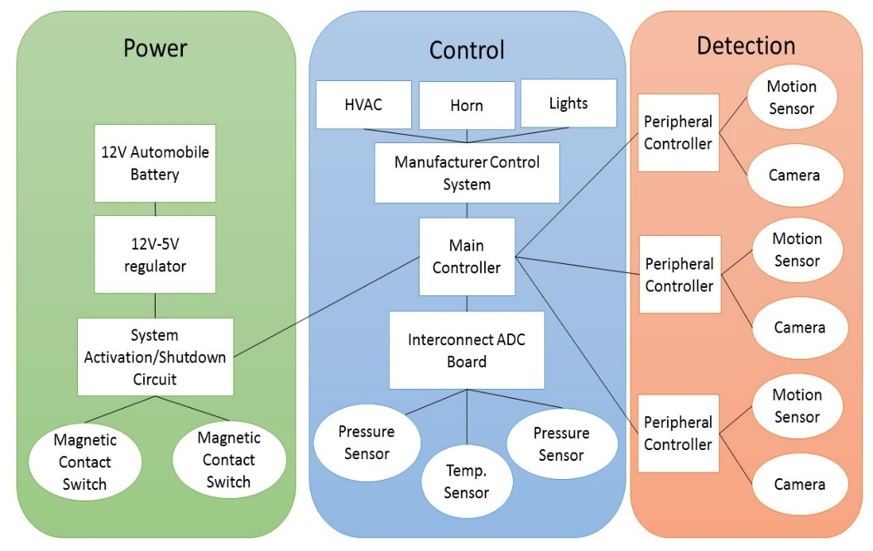
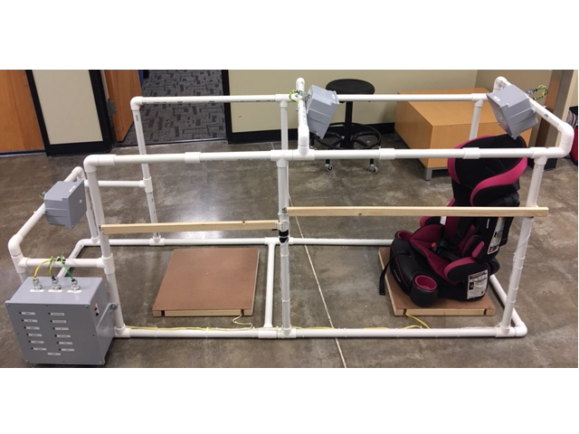
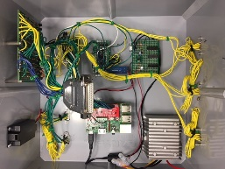
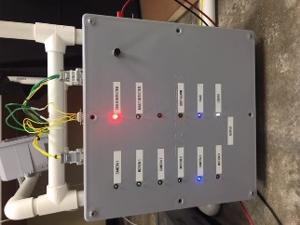
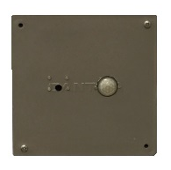
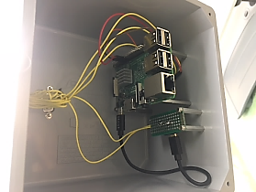

Integrated Automobile Child Detection System IACDS
UTDesign II: Fall 2017
Mentor: Marco Tacca
Jason Hoff (EE), Matthew Oakley (EE), Roberto Jimenez (EE), Carlos Rodriguez (EE)
jxj143230@utdallas.edu, matthew.oakley@utdallas.edu, rxj122630@utdallas.edu, cxr130830@utdallas.edu
The goal of the Integrated Automobile Child Detection System, or IACDS, is to detect a child left behind in a car and notify bystanders in the surrounding area, while taking measures to increase the survivability of the incident for the child.
ENVIRONMENT
PROTOTYPE
DESIGN OBJECTIVES
RESULTS
RESULTS
Low Cost
Zero Network Connectivity
Integrated
Positive Detection Rate ≥ 89%
False Positive Rate ≤ 10 %
Soft-Alarm Detection Time ≤ 45s
Hard-Alarm Detection Time ≤ 60s
Correct Output ≥ 89%
 | I (A) | V (V) | P (W)
Min | 0.026 | 12.2 | 0.317
Max | 0.858 | 12.2 | 10.467
Spike | 1.014 | 12.2 | 12.371
Average Soft Alarm Time from Boot = 28.5s
Average Hard Alarm Time from Boot = 40.28s
Average Hard Alarm Time (Booted) = 4.69s
Positive Detection Rate = 83.56%
False Positive Rate = 13.70%
Correct Output = 72.60%
Erik Jonsson School of Engineering & Computer Science - The University of Texas at Dallas

Slide 3
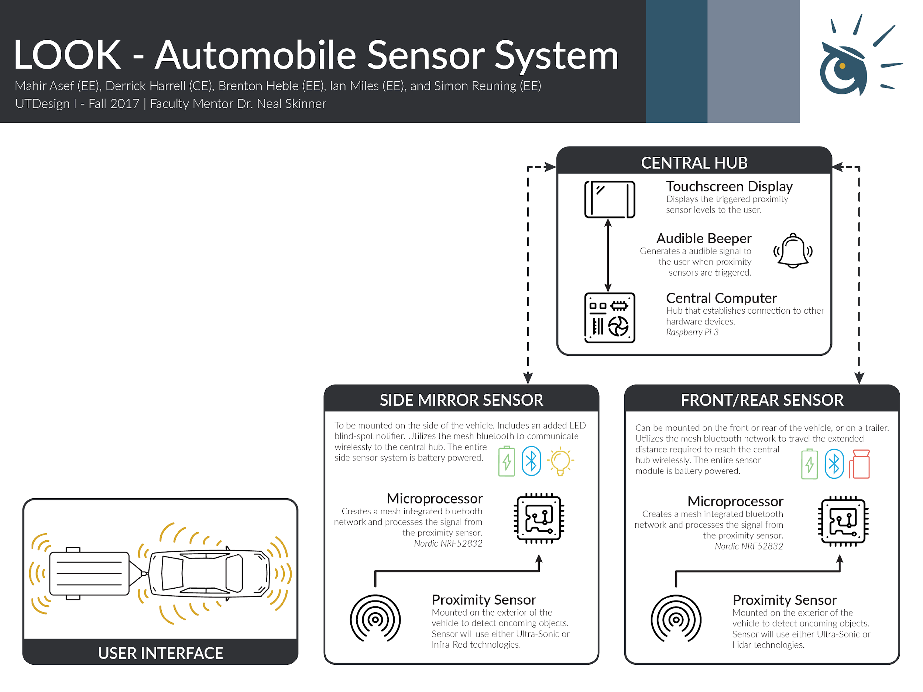
Description
To design a fully functional sensor system that can be universally fitted on a vehicle or trailer. The system will assist the driver parking and with blind spot detection. The overall goal is to prevent accidents and as a result, lower the potential for injuries.
Performance Metric
This project shall be considered satisfactory upon building a working model that has front, rear, and side blind spot detection. Objects shall be detected within 5m of the vehicle and or trailer and notify the driver.
Current Status
The LOOK team is able to successfully read data from multiple sensors wirelessly and display their status on a graphical interface.
Notes:
Powerpoint slide submission requirements: (from email)
Must include project title, team member names & majors-initials only, UTDesign I/II on the title box).
Must have Performance Metrics (What is your metric? How did you measure it? How does your solution compare to the design requirement for this metric?)
Slide format: Landscape; 10” x 7.5” (4:3)

Slide 4














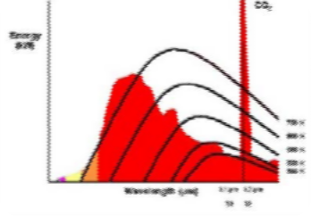



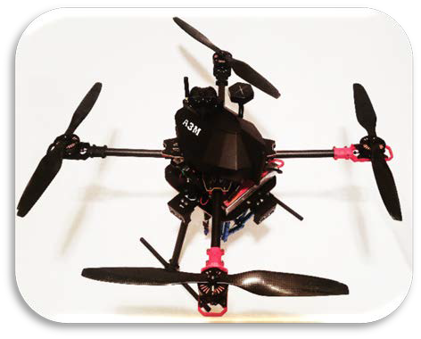
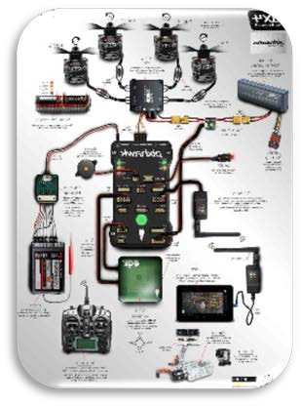




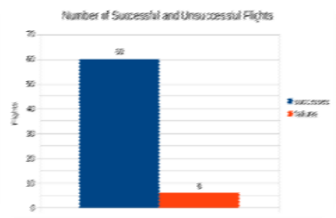







Alex Vish [EE], Mustafa Shahid [EE], Mike Hinkle [EE], Michael Camara [EE]
The primary objective for our team is to design an autonomous drone capable of detecting and extinguishing an indoor fire
The drone will be capable of collision avoidance while conducting fire watch within a pre-programmed boundary
The drone will be able to patrol and detect the fire
The drone’s flight time will be at least 20 minutes long with the ability to independently return to its self charging station
UV/IR Flame Detector (120 DEG.) UV Optical sensor is integrated with IR sensor creating a dual band detection increasing the range to up to 200ft and decrease the false flame detection from masking of other sources.
Drone Caption at 70% Completion
Figure 2: Energy vs Wavelength for UV/IR Flame Detection
The PixHawk advanced flight controller is the central hub for the drone connected with motors, servos, and GPS as a transmitter. The data to flight controller is fed through Arduino to control the tasks
PixHawk with Arduino controls the autonomous program which also receives data from the Arduino mini. The Arduino is connected with the battery indicators and sensors that include the following: sonar receivers and transmitters for collision detection, long range UV/IR flame detectors for fire detection, and sensors for a self charging alignment system.
Motors (380kv)
Autonomous Program
Alignment System
Battery Indicators
Figure 1: PixHawk Connections (3DR Robotics)
Arduino UNO R3
Arduino Mini
Sensors
Active Collision Detection
Flight Controller
GPS + Indoor GPS
Marvel Mind
Preset Collision Detection
Thermal Detection
Telemetry (MLINK)
Initial Ground Settings
Figure 3: Flight Success Chart

Slide 5

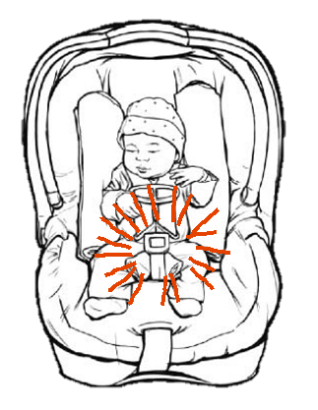
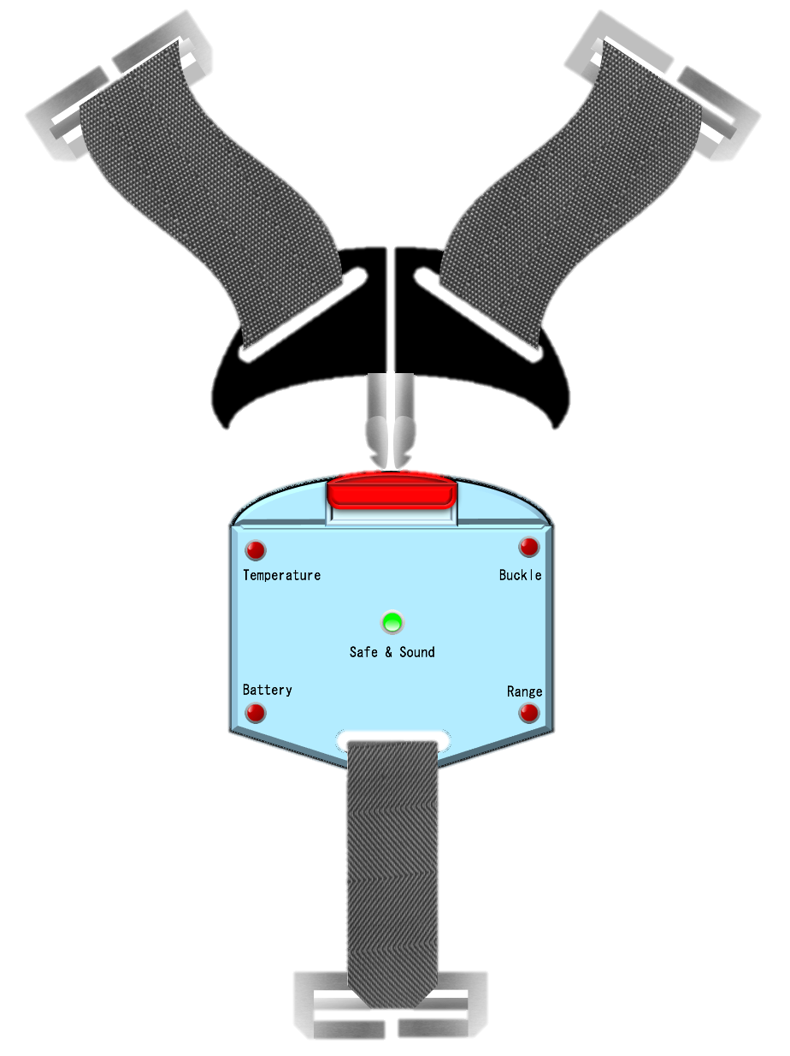
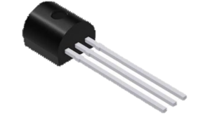
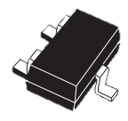
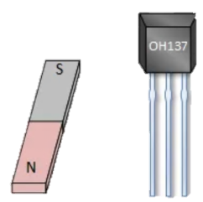
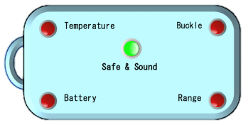
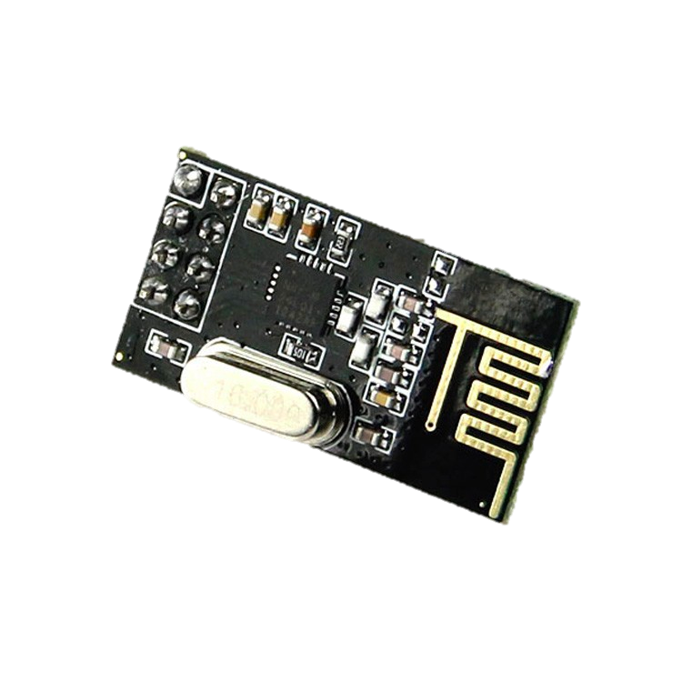
Baby
Safe
Baby Safe
Erik Jonsson School of Engineering & Computer Science
The University of Texas at Dallas
UTDesign I: Fall 2017
Faculty Mentor: Neal Skinner
Company Sponsor: Jason Davis
Edgar Vela (CE) | Jorge Villa (EE) | Uriel Romero (CE) | Isaac Juarez (CE) | Catarino Almeida (TE)
Problem
Metrics
The child mortality rate due to being left in automobiles is at an all time high. Currently, there are no wide-scale baby-monitoring devices out there that can help solve this problem.
Temperature _______________
Is the temperature between 55°F - 90° F ± 3° F
Battery ______________________
Is the battery below 20% ± 1% of full capacity?
Buckle _______________________
Is the hall effect sensor detecting a magnetic field?
Range ________________________
Is the Key Fob within 20 feet (±5 ft.) of the Baby Safe?
BABY SAFE
TI Precision Temp.
Sensor LM135
Objectives
Baby Safe Design – to implement a device that is simple to use and install
Key Fob Design – to implement a device that is portable, durable, and can report what is going on with the baby safe
Accuracy – the device must work efficiently and display correct readings
Stability – to withstand long hours of use without significant battery drain
Cost – ensure the device is affordable by using inexpensive components
ST Microelectronics
Voltage Detector
STM1061
KEY FOB
Allegro Microsystems OH3144E
Hall Effect Sensor
Wireless Transceiver 2.4Ghz NFR24L01

Slide 6



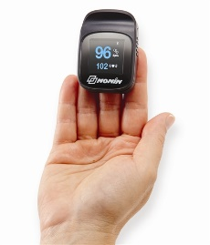
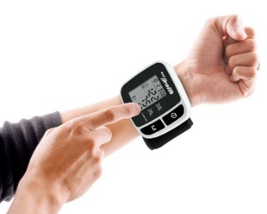

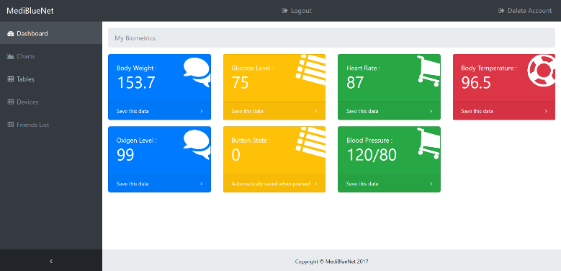

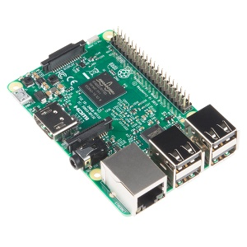

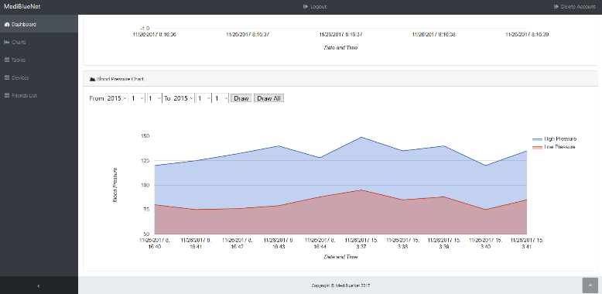

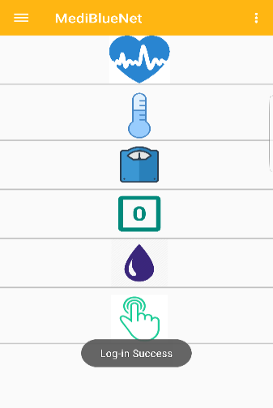
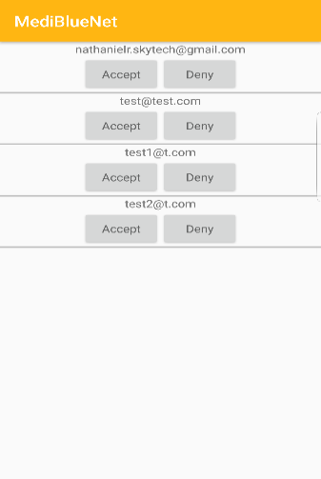
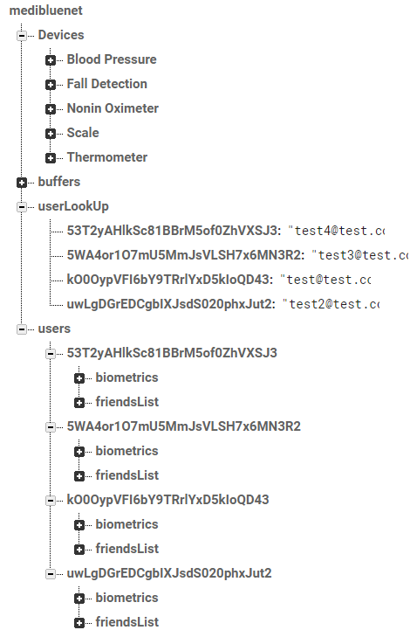


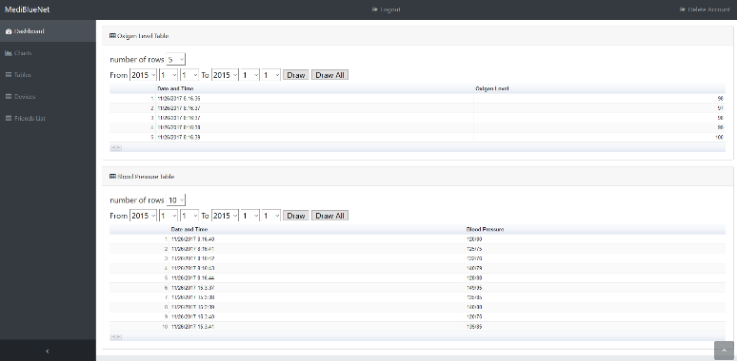

Medical-Internet-of-Things (m-IoT) Bluetooth Router with Application
UTDesign II: Fall 2017
Nathaniel Rodriguez(EE) Namhyung Lee(EE) Reshard Ferguson(CE) Yunjung Lee(CE)
Web Application
At least 6 medical devices
9 hours battery life
Main Page
Android Application
Chart
Main Screen
Friends List
Performance Metric
Decrease time it takes to record biometrics significantly
- Save about 10 seconds for each measurement
Multiple medical devices are integrated in one system
- At least 7 medical devices in one system
Complete system within $2000
- Spent only 40% of budget
Device mobility
- 9 hours battery life for normal use
Table
Realtime Database

Slide 7


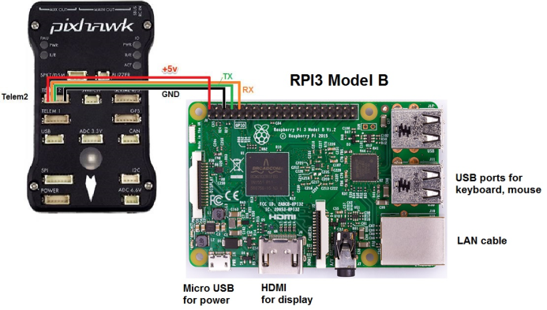
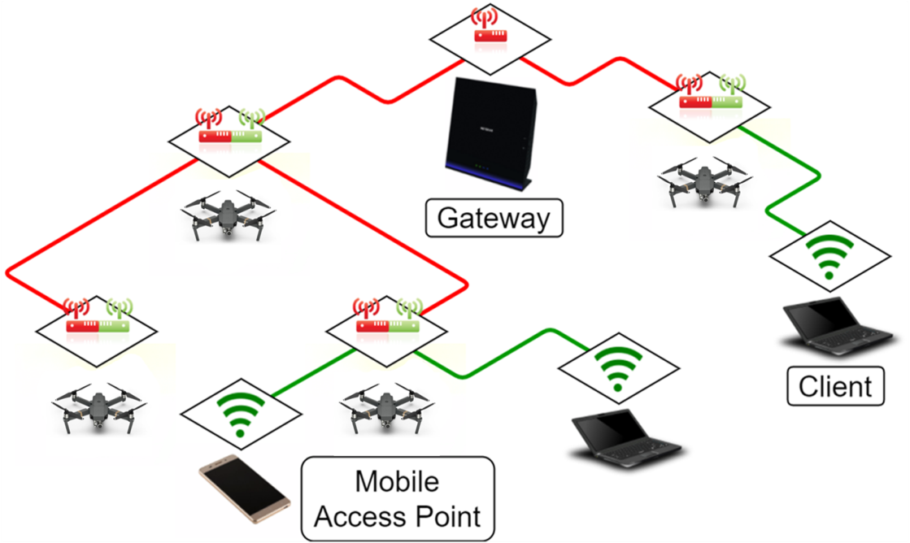
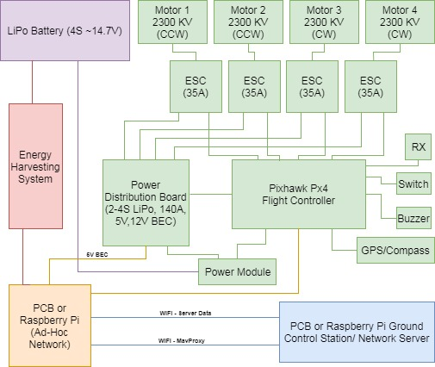
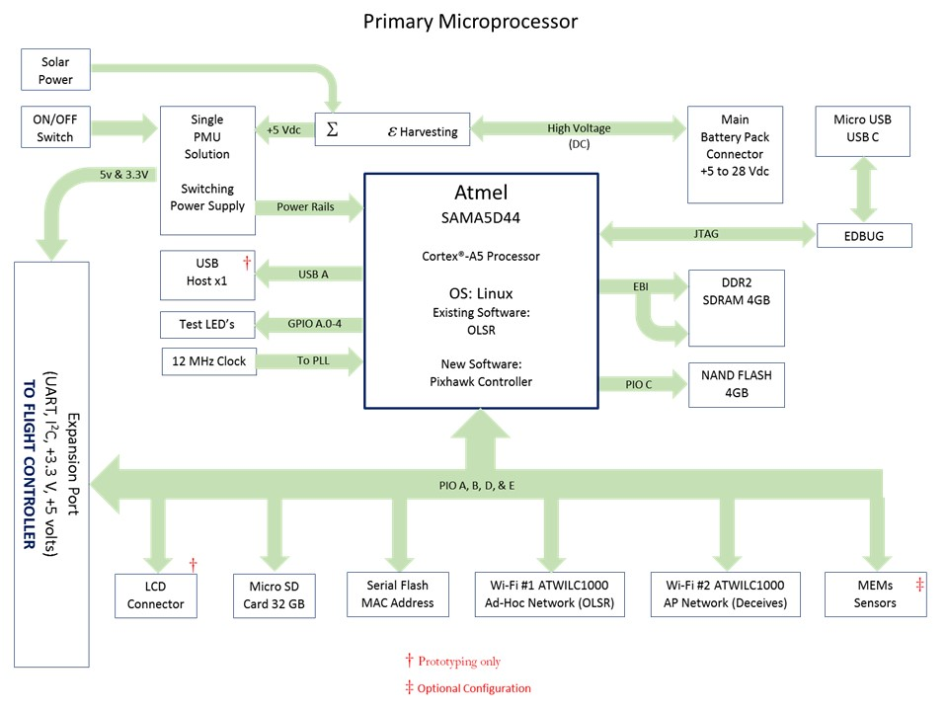
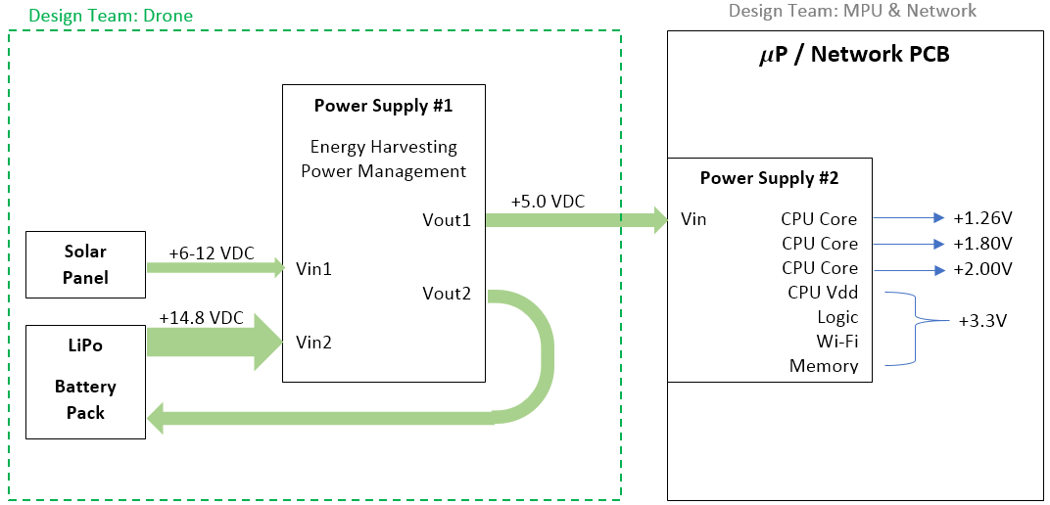

Mobile Wireless Mesh Network Extenders Steven Foster (EE), Jayson Smith (EE), Zane Hovey (CE), Joseph Elbaz (EE), Alex Toy (EE)
How do we bring internet connectivity to areas that are isolated or have a decimated infrastructure?
Traditional networks are limited in their stationary infrastructure. Most ad-hoc networks only emphasize interconnectivity. Areas with limited to no internet connectivity can benefit from a mobile ad-hoc network. Potential applications include: military, disaster relief, and developing areas.
Objectives :
Allow clients to access internet in remote areas
OLSR Networking to create a mesh Wi-Fi Network
Develop a system that delivers the access point
Implement a drone for delivery
Automate the delivery process
Utilize Pixhawk navigation software for GPS tracking and navigation
Extend system duration
Utilize a solar and power management system

Slide 8
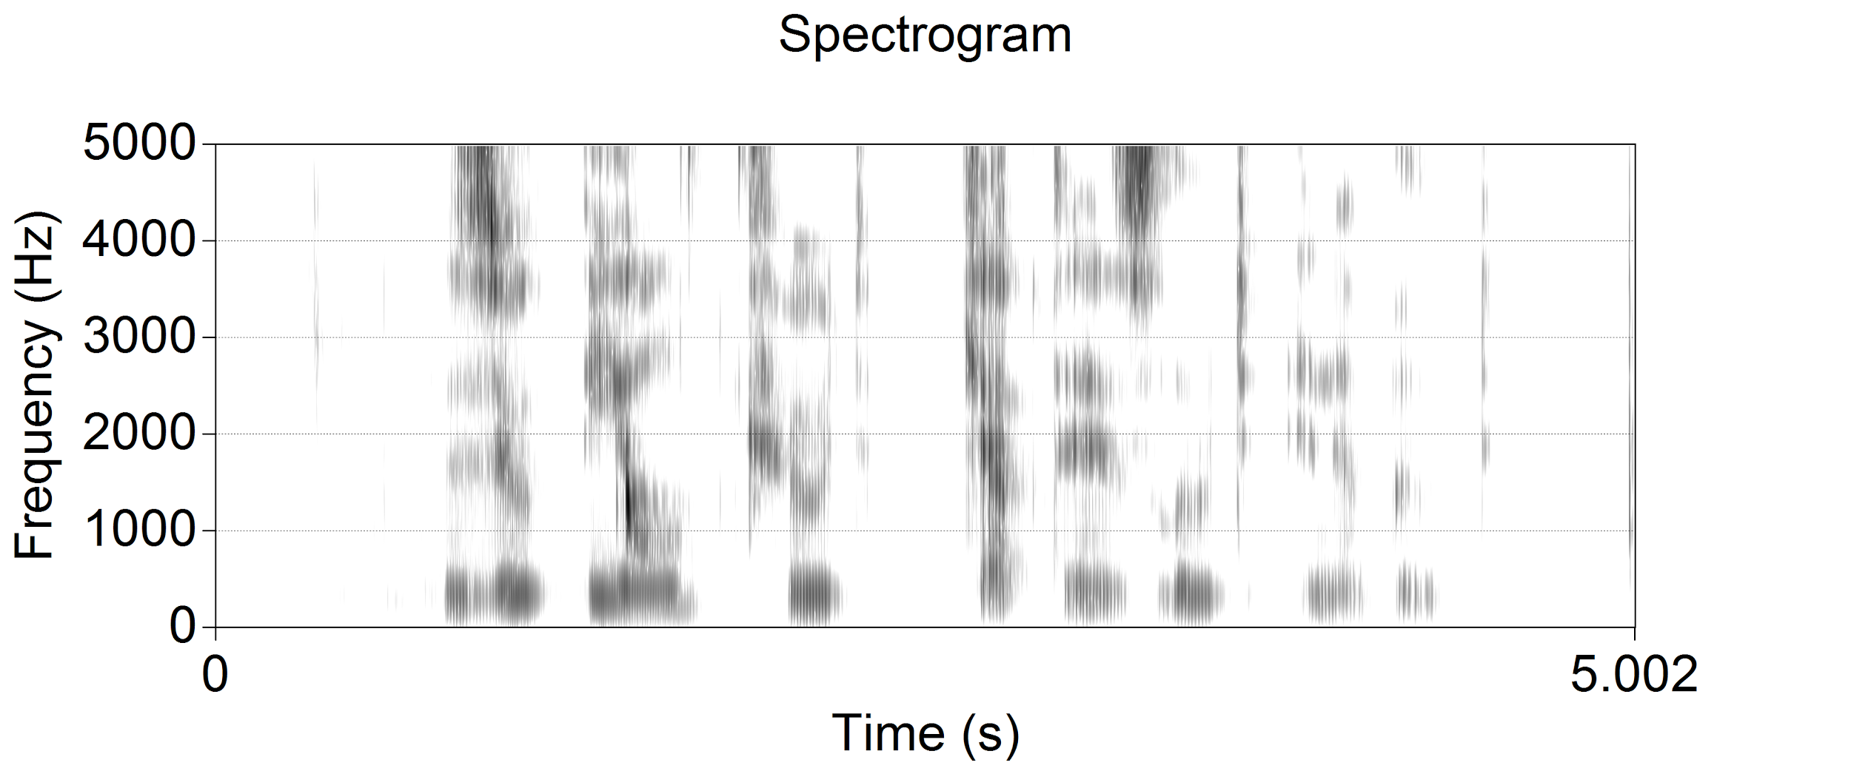
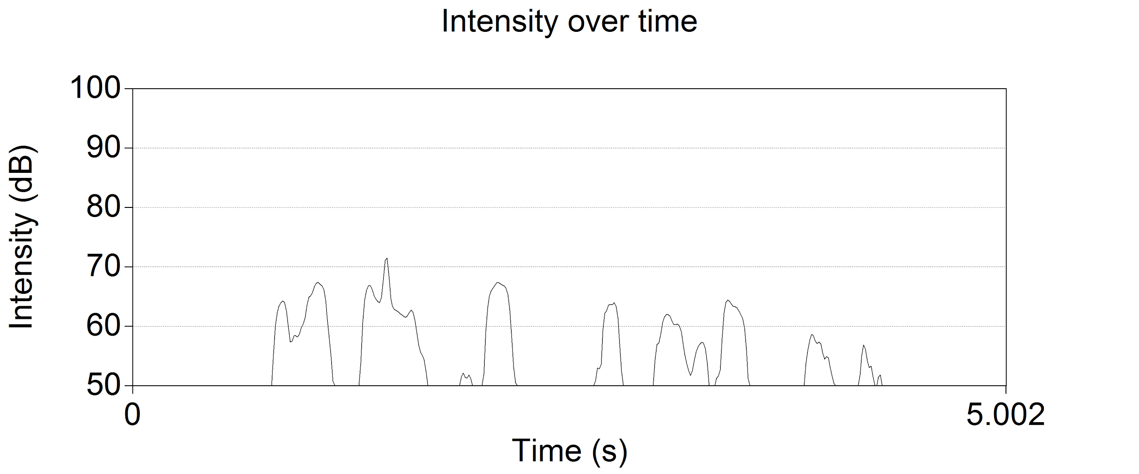
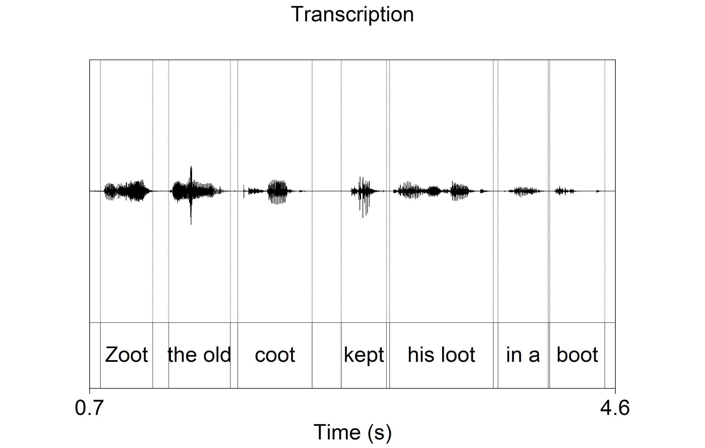
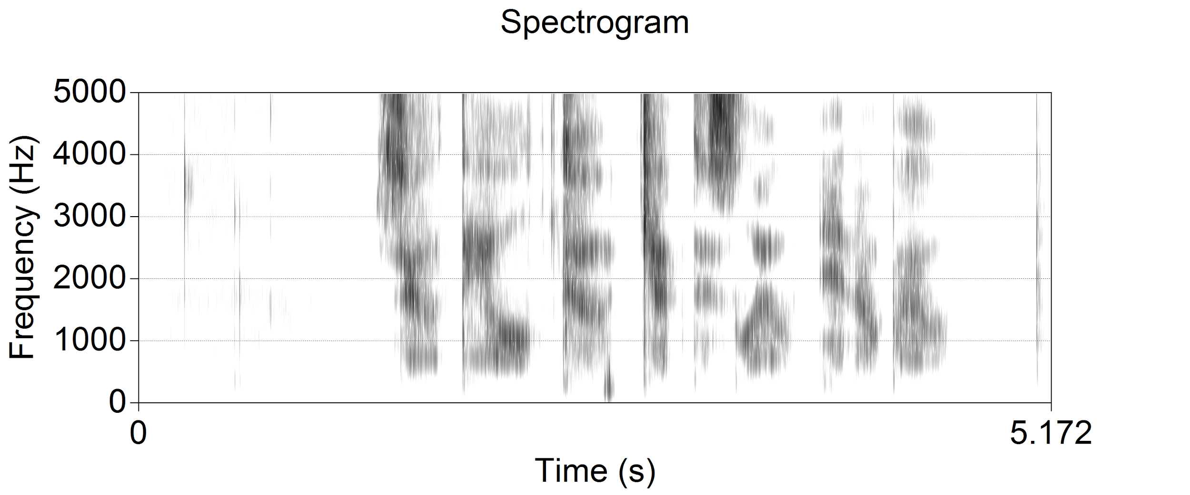
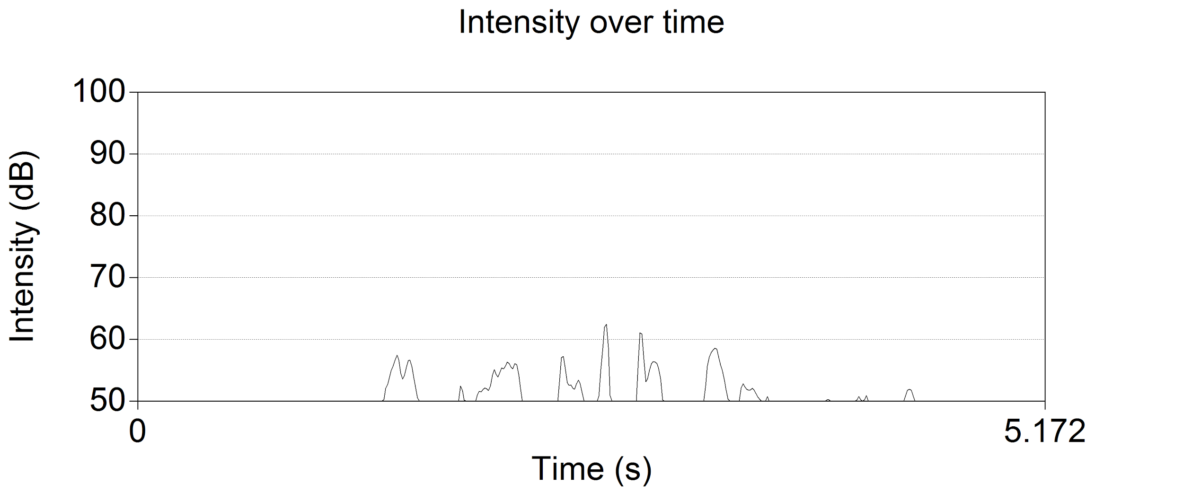



The Impact of Vocal Effort on Speech
UTDesign I: Fall 2017
Sebastian (Pradeep) Fonseka (EE/CS), Julie Bowser (EE), Michael Nelson (CE), Alexander Tomkovich (CE), Ji Yun (EE)
Data Collection
30-100 subjects
3 phases to get varied results
Collected over 2-4 months
Goal is to induce variations in vocal effort
Data Analysis
Feature parameters
Formants
Fundamental frequencies
Pitch patterns
Etc.
Transcription
Notating the audio samples with text and timestamps
Segments speech versus silence/non-vocal audio
Modeling
A robust model is infeasible
Heuristic model as second choice
Looking for correlation between data points
Collect Data
Analyze Data
Performance Metric
Establish neutral baseline
Assess non-neutral speech state
Weighted combination of feature parameters
At least 50% success rate of non-neutral detection
Transcribe Data
Model Data
Test Model
Figure 1. Flow chart of project tasks
(a)
(b)
(c)
(d)
Figure 3. Spectrogram (a) and intensity (b) of neutral speech and
spectrogram (c) and intensity (d) of whispered speech
Figure 2. Sound wave and aligned transcription

Slide 9



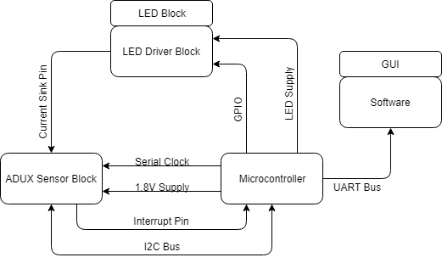
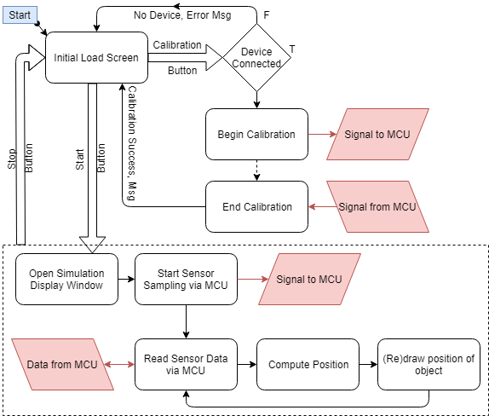
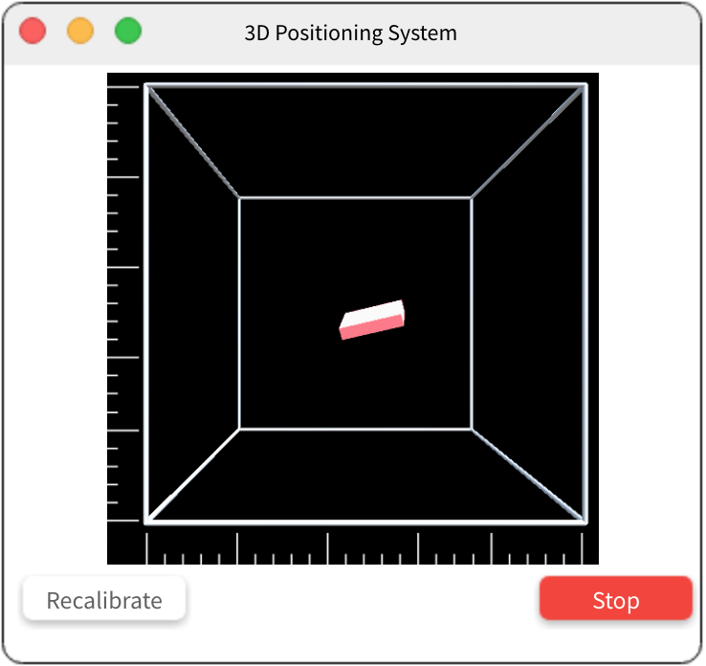
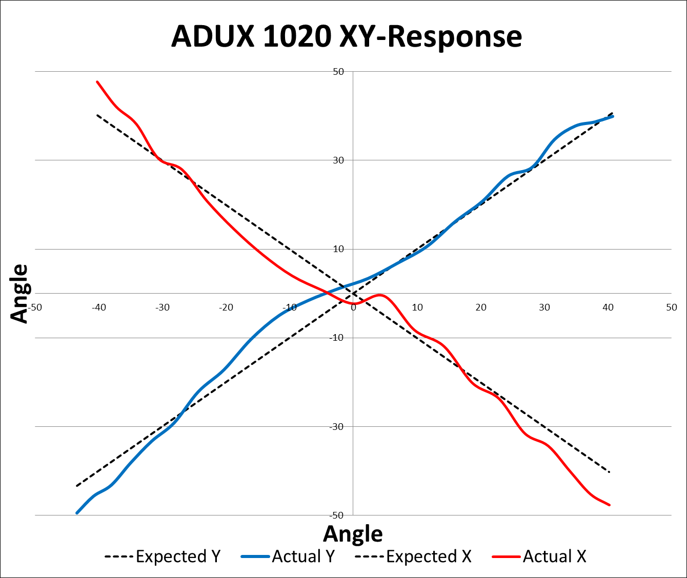
3D Optical Positioning System
UTDesign I, Fall 2017
Dhiren Kisani (CE) - Mikhail Tishechkin (CE) - Nathan Smith (EE) - John Thurman (CE) - Abdullah Khan (EE)
Background/Problem
Lack of general-use 3D positioning systems
Existing systems are high cost and/or specialized (Xbox Kinect, Wii)
Lack portable interfacing without additional hardware (i.e. expensive console)
Cheap systems lack fine accuracy
Project Goals
Track position and motion of an object in an initially controlled environment
Low cost system with simple interface
Applicability to variety of trackable objects
Track motion of up to 1 m/s, < 1 mm stationary accuracy, ~30 cm range
Metric | Goal | Estimate
Cost | <$15 | ~$12
Power | <5W | <3W
Range | >30cm | ~40cm
Accuracy | 1mm | TBD
Speed | 1m/s | TBD
Eye Safety | Any distance | Any Distance
Proposed Design
GUI Mock-Up
Overall System Flow Diagram
Software Flow Diagram
Conclusion: Our proposed system is lightweight; low cost (~$12); low power (<3W); and consists of a sensor block, an MCU, an LED block and a user-friendly UI. We designed our system around a largely integrated sensor, reducing system complexity and allowing for a lower hardware profile. The TI MSP432 MCU is an excellent choice for low power system control and the ADUX1020 facilitates the precision we require.

